Slide 1
CLIL-NATURAL SCIENCES: ANIMALS

Slide 3
* Match the words with their suitable definitions:
WORDS | DEFFINITIONS
1/ feather | a/ is in the body that you use for breathing.
2/ scale | b/ is one of the many soft light parts covering a bird’s body.
3/ legs | c/ are the long parts of an animal that its feet are joined to.
4/ hair | d/ is one of the parts of the body of a bird, insect that it uses for flying.
5/ wing | e/ is one of the thin body parts that a fish uses to swim.
6/ lung | f/ is one of the openings on the side of a fish’s head that it breathes through.
7/ fin | g/ is the row of connected bones that go down the middle of your back.
8/ backbone | h/ grows on the body of a person or an animal.
9/ gill | i/ is one of the small flat pieces of skin that cover the bodies of fish.

Slide 4
* Match the words with their suitable definitions:
WORDS | DEFFINITIONS
1/ feather | a/ is in the body that you use for breathing.
2/ scale | b/ is one of the many soft light parts covering a bird’s body.
3/ legs | c/ are the long parts of an animal that its feet are joined to.
4/ hair | d/ is one of the parts of the body of a bird, insect that it uses for flying.
5/ wing | e/ is one of the thin body parts that a fish uses to swim.
6/ lung | f/ is one of the openings on the side of a fish’s head that it breathes through.
7/ fin | g/ is the row of connected bones that go down the middle of your back.
8/ backbone | h/ grows on the body of a person or an animal.
9/ gill | i/ is one of the small flat pieces of skin that cover the bodies of fish.
1-b, 2-i, 3-c, 4-h, 5-d, 6-a, 7-e, 8-g, 9-f

Slide 5
1/ Match the words in the box with the pictures 1-9 then complete the text with the correct words:
feathers, scales, legs, hair, wings, lungs, fins, backbones, gills

Slide 6
1/ Match the words in the box with the pictures 1-9 then complete the text with the correct words:
legs
hair
wings
lungs
fins
backbones
gills
scales
feathers

Slide 7
2/ Complete the text with the correct words in the box:
feathers, scales, legs, hair, wings, lungs, fins, backbones, gills

Slide 8
fins
gills
legs
scales
lungs
hair
feathers
wings

Slide 9
3/ Read the text again and answer the questions:

Slide 10
3/ Read the text again and answer the questions:
1/ Which type of animal doesn’t live on land?
-> Fish doesn’t live on land.
2/ Which types of animals have got scales?
-> Fish and reptiles have got scales.
3/ Which type of animal hasn’t got lungs when it’s young?
-> Amphibians haven’t get lungs when they are young.
4/ Which type of animal feeds its babies milk ?
-> Mammals feed their babies milk.
5/ Which type of animal is different when it’s older?
-> Amphibians are different when they are older.

Slide 11
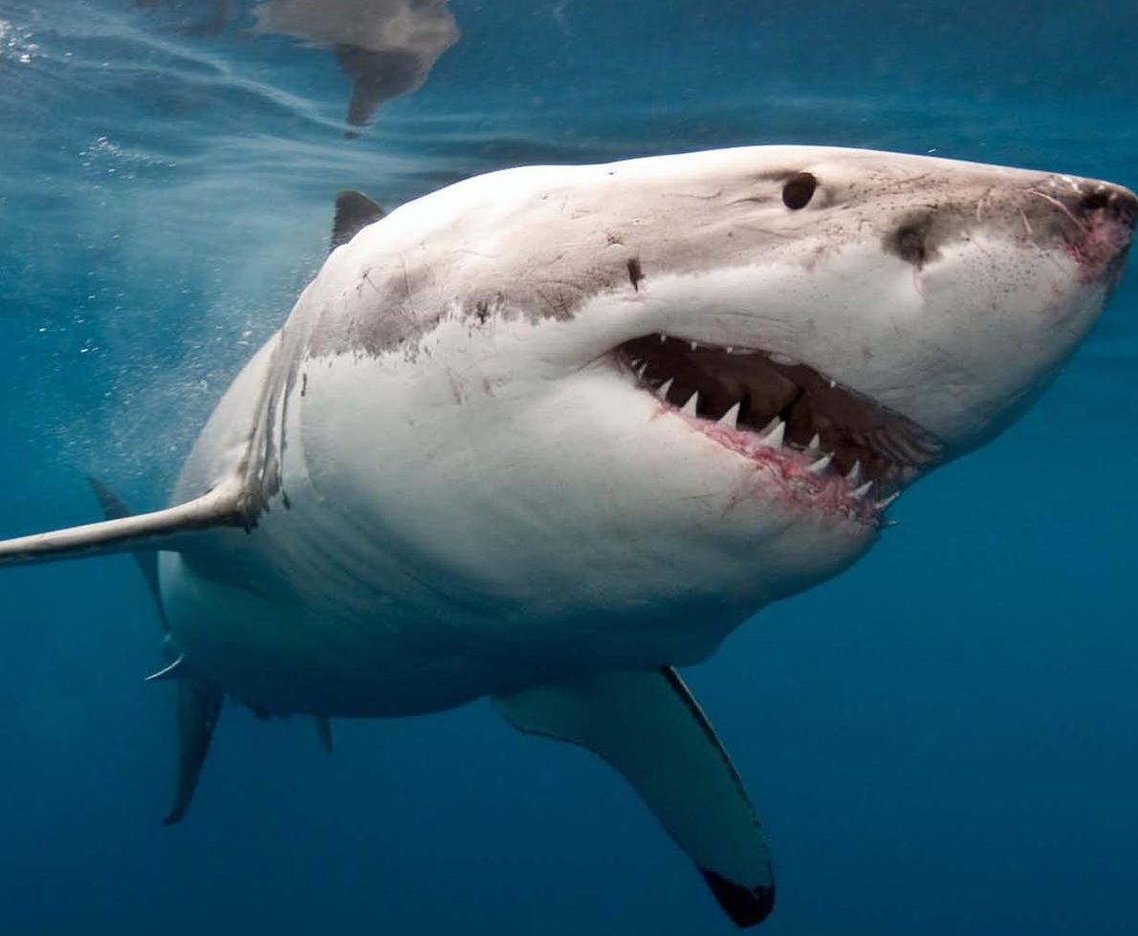
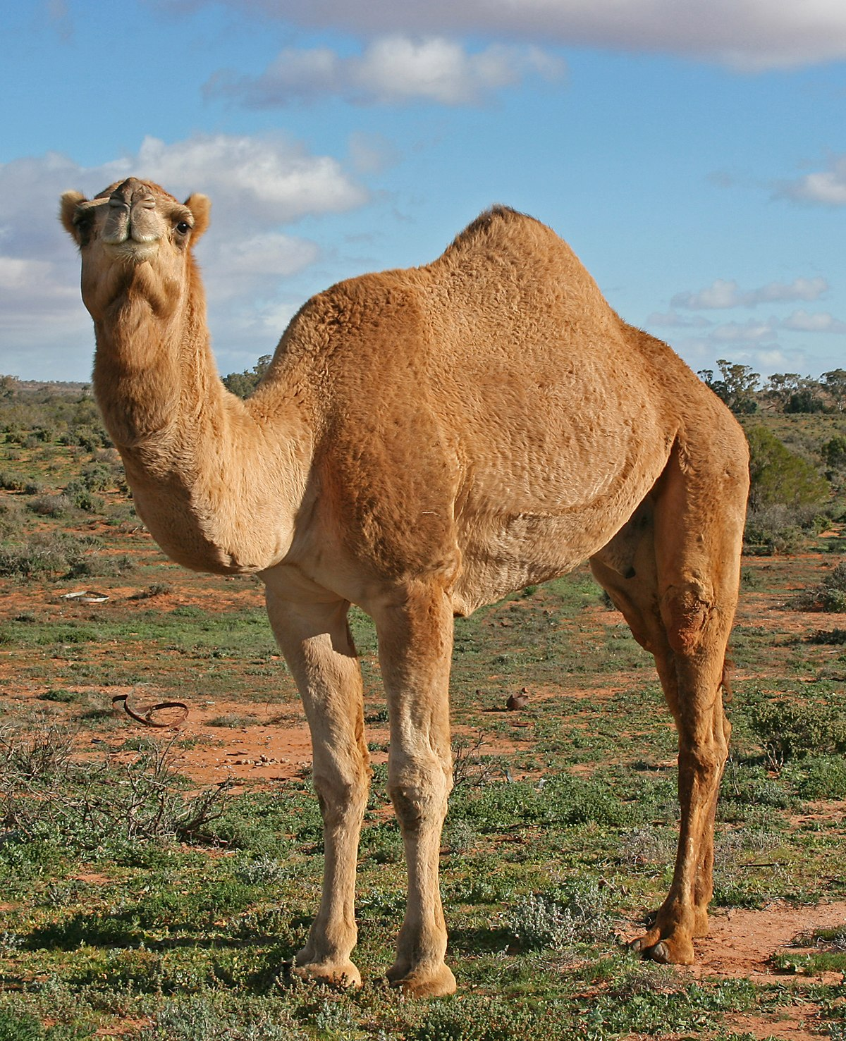
shark
camel
eagle
crocodile

Slide 13
A crocodile is a reptile.
A shark is a fish
A camel is a mammal.
An eagle is a bird.

Slide 14
GUESSING GAME
Work in groups. Take turn drawing and guessing animals from unit 3. One student draws the animals for other students . The first student to guess correct the animal will win the points.

Slide 15
* Homework: - Learn by heart all the new words. - Prepare for the next lesson – Unit 3: Puzzles and games.

